Slide 1
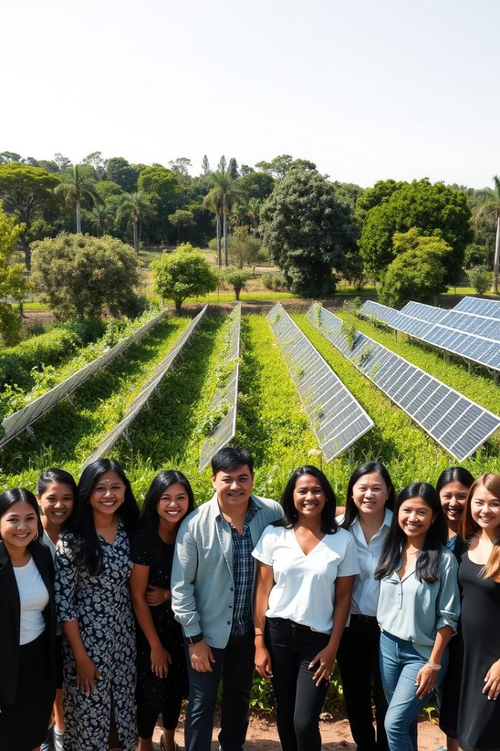
CS Department ERP
The aim of the CS Department ERP is to streamline administrative processes and enhance student engagement by addressing specific needs not met by the current college ERP.
By-:
Pragya Pandey (2100290120121)
Pratul Pandey (2100290120127)
Nilesh Verma(2100290120114)
Nishant (2100290120115)
Project Guide-: Mrs. Arti Sharma

Slide 2
Project Abstract
Overview
Key Objectives
Approach
The CS Department ERP is a custom-built management system using the MERN stack, developed to address limitations of the current college ERP and provide essential tools for both administrative efficiency and student development within the department.
Improve administrative efficiency, enhance student engagement, and create a user-friendly interface.
Conduct needs assessment, develop modularly on the MERN stack, gather iterative feedback, and ensure user training for smooth adoption.

Slide 3

Project Goals and Objectives
Streamline Department Processes
1
Automate tasks like NOC applications and FDP management to increase efficiency.
2
Support Student Development
Enable students to showcase skills and access growth resources.
Improving Communication and Collaboration
3
Facilitating seamless interaction between the stakeholders.

Slide 4

Alignment with UN Sustainable Development Goals (SDGs)
SDG 4: Quality Education
SDG 9: Innovation and
Infrastructure
Promote inclusive, equitable education and lifelong learning.
Foster resilient infrastructure and sustainable industrial innovation.
SDG 17: Partnerships for the Goals
Strengthen global partnerships to support and achieve the SDGs.

Slide 5




Expected Outcomes and Impact
Increased Administrative
Efficiency
Enhanced Student Engagement
Improved User Experience
Access to tools for skill development and achievement showcase will boost student involvement and support career growth.
A user-friendly interface tailored to department needs will provide easy access to essential information, improving satisfaction and adoption.
Automation of key processes like NOC applications and document management will save time and reduce manual workload for staff.

Slide 6

Key Project Deliverables
Functional CS Department ERP
System
A fully functional ERP with
modules for NOC, FDP management, and student profiles.
User Guides and Training
Documentation and training materials for easy system adoption.

Slide 7
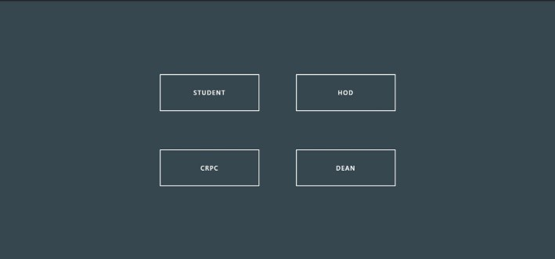
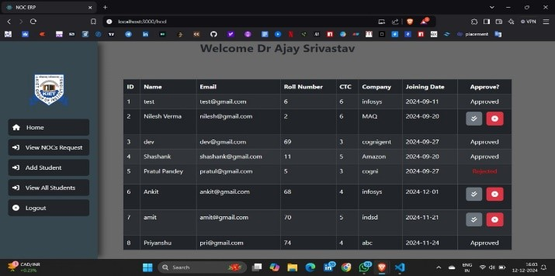
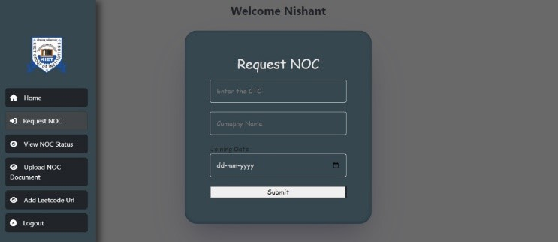
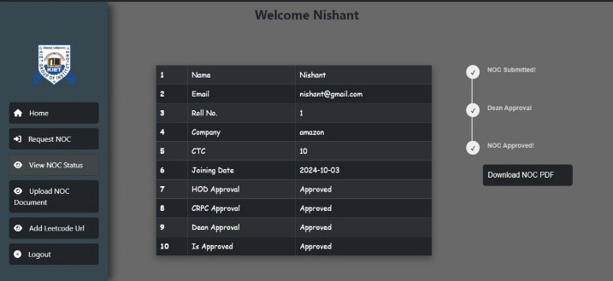
Snapshots-:

Slide 8
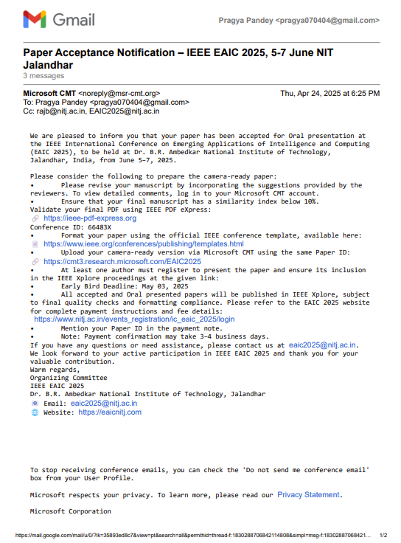
Research Paper Acceptance Proof-:

Slide 9

Next Steps and Conclusion
1
Final Testing and
Deployment
2
User Training and
Onboarding
Conduct thorough testing to ensure system stability before rolling out to users.
Provide training sessions and resources to ensure smooth adoption by students and faculty.
3
Monitor and Evaluate
Continuously assess the project's performance and make adjustments to optimize its effectiveness.

